Slide 1
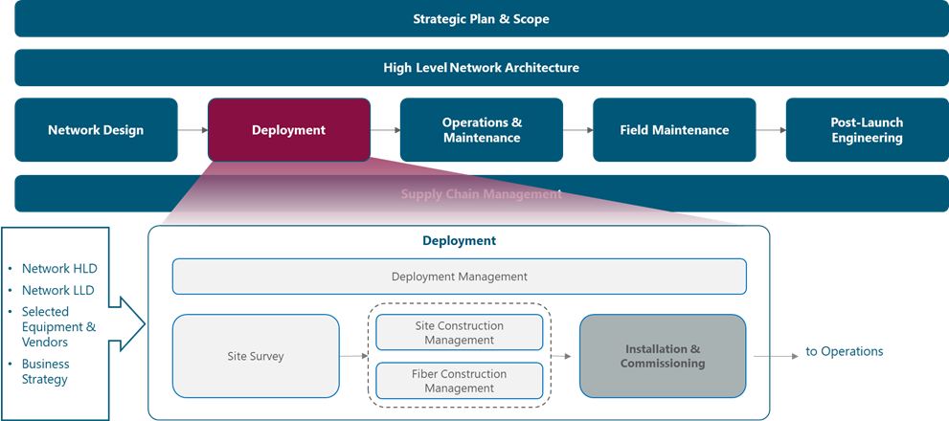
Figure 1. Network Deployment and Management Framework

Slide 2
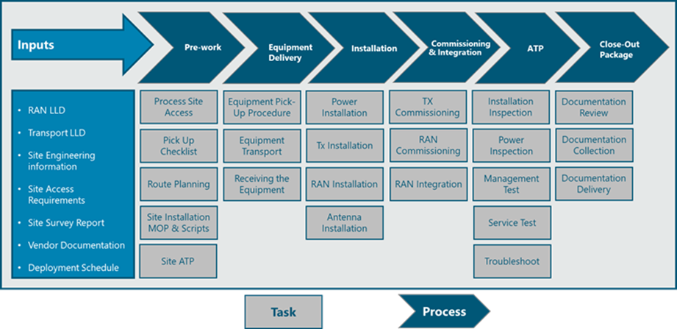
Figure 2. Installation & Commissioning Process view.

Slide 3
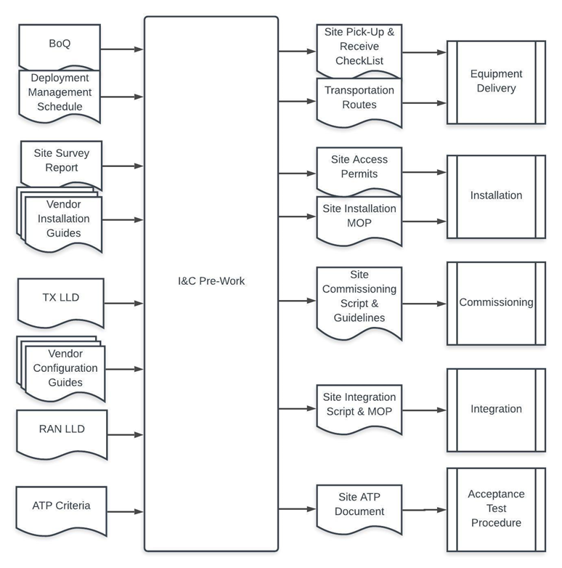
Figure 3. Installation & Commissioning Functional view

Slide 4
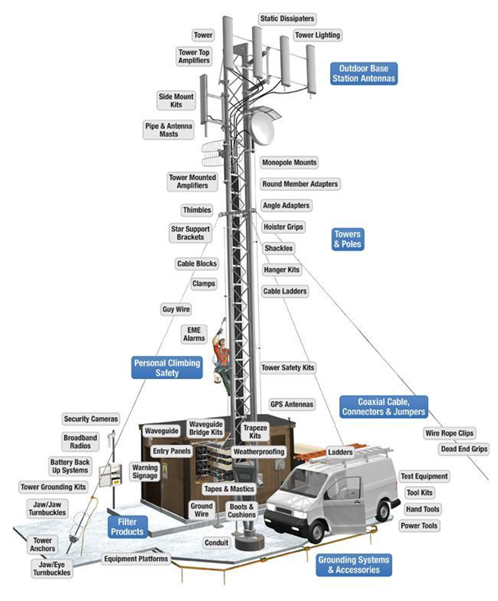
Figure 4 Common Scenario of a Base Station

Slide 5
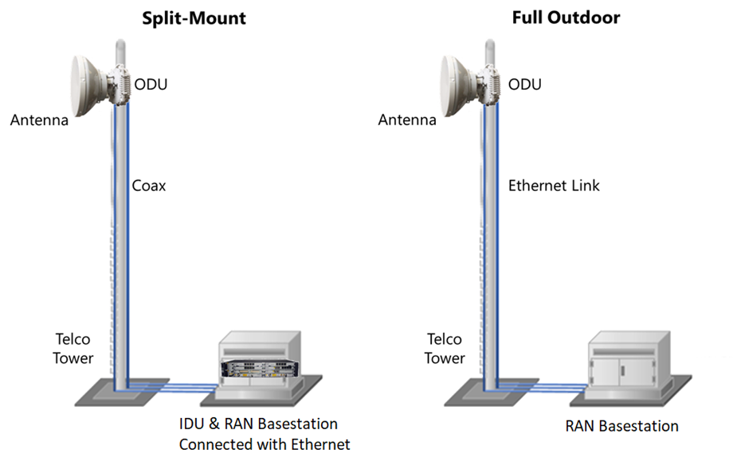
Figure 5 Microwave Installation Scenarios

Slide 6
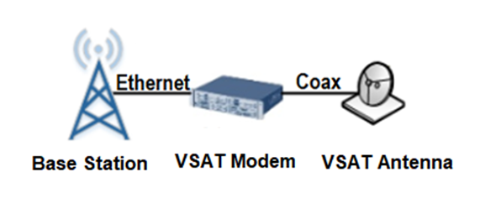
Figure 6 Satellite Backhaul Solution

Slide 7
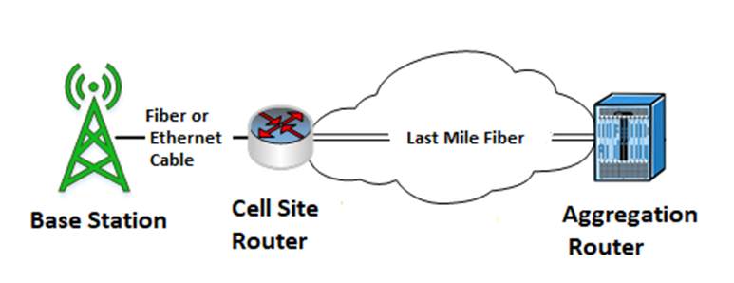
Figure 7 Fiber Last Mile Construction

Slide 8
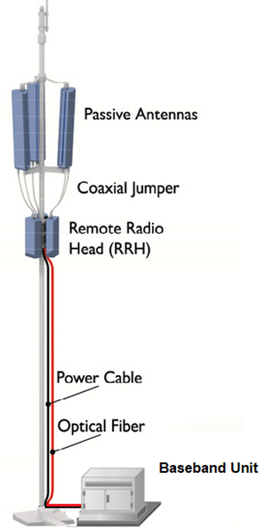
Figure 8 RAN Equipment installed in a monopole

Slide 9
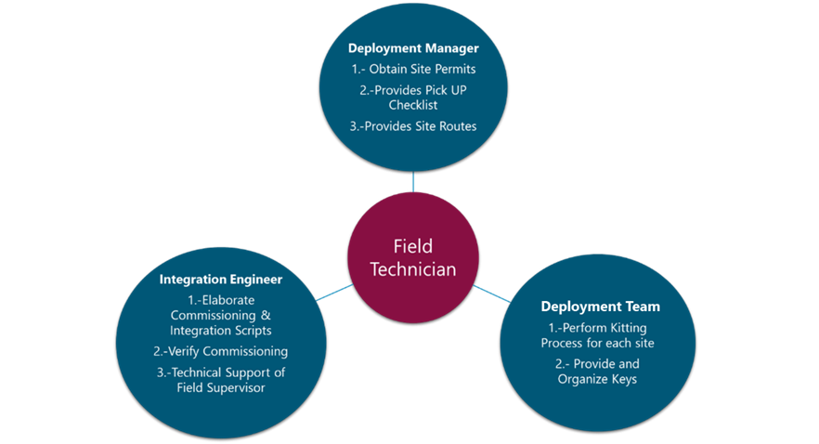
Figure 9 The Low-Tech Model

Slide 10
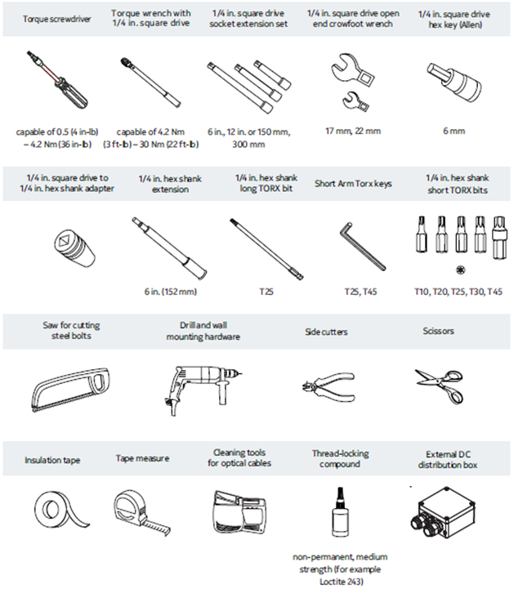
Figure 10 Common Tools used in RAN equipment installation

Slide 11
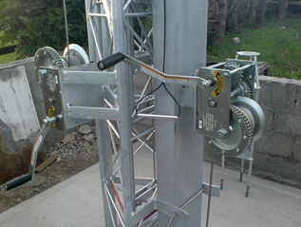
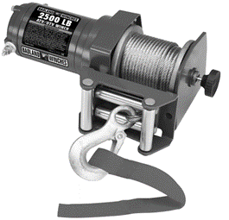
Figure 11 Commonly used winch for tower installation

Slide 12
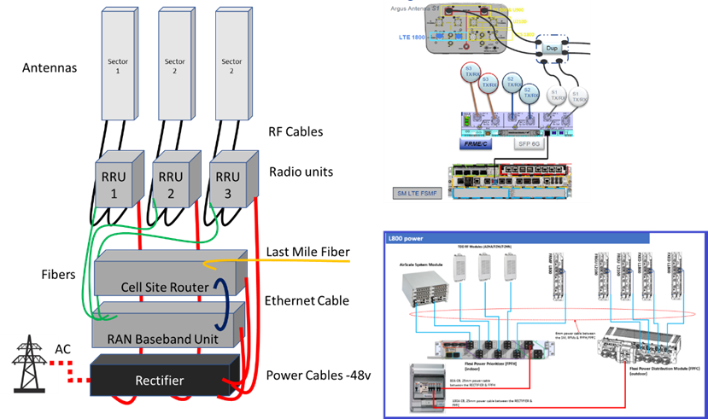
Figure 12 Connection Diagrams used in Actual Methods of Procedure

Slide 13
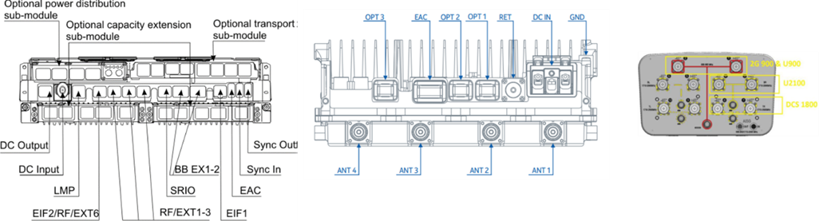
Figure 13 General Physical Interfaces of RAN Equipment

Slide 14
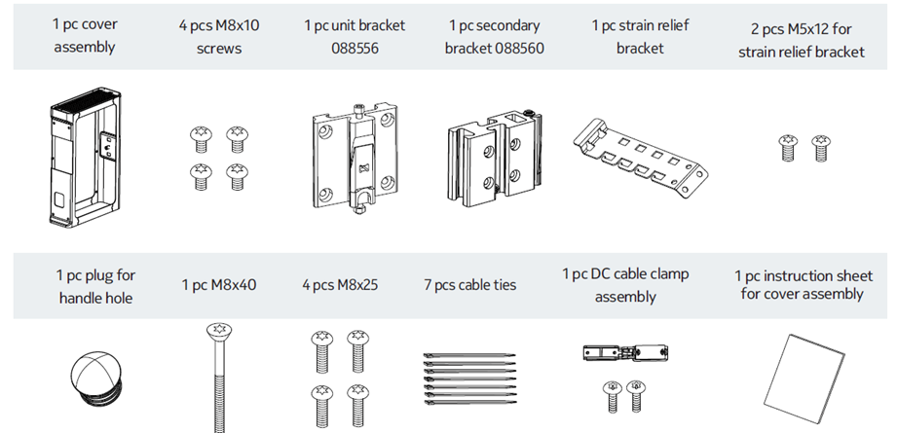
Figure 14. Ancillaries required for the installation of a Radio unit

Slide 15
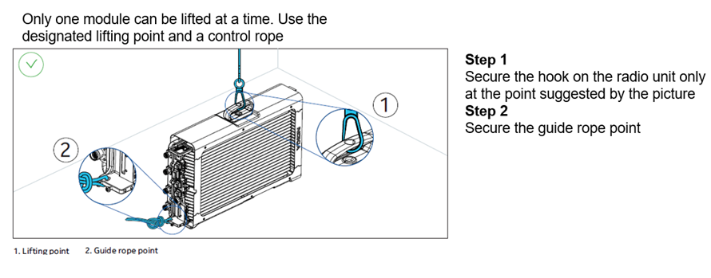
Lifting the Radio Unit :

Slide 16
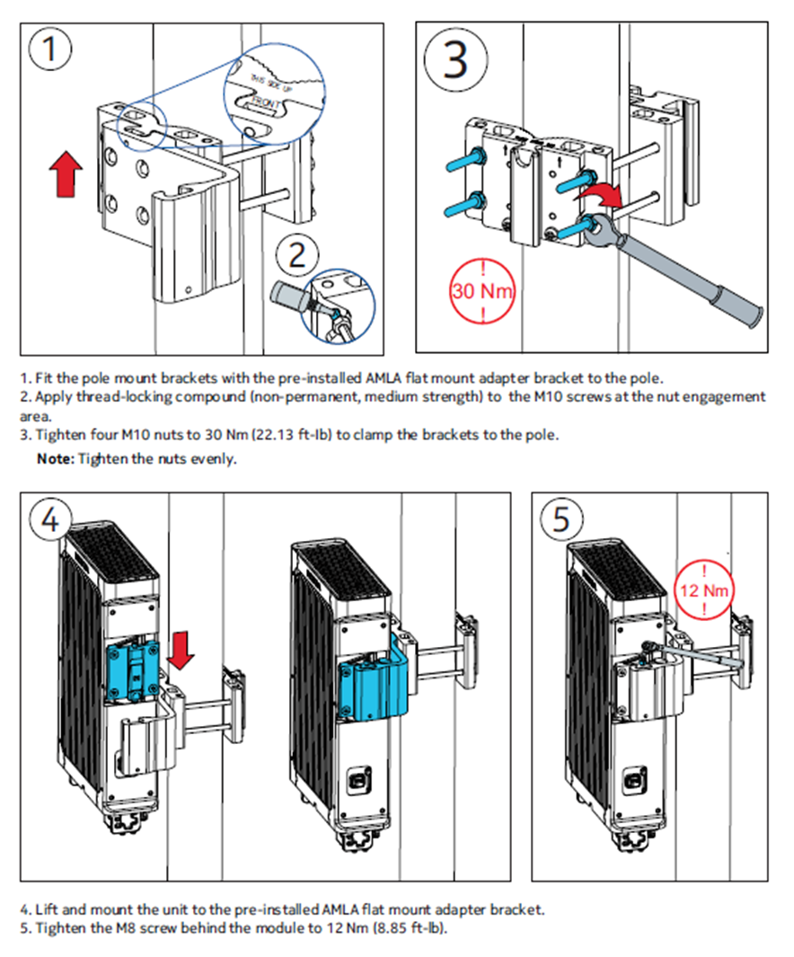
2. Installing the Radio Unit on a Pole:

Slide 17
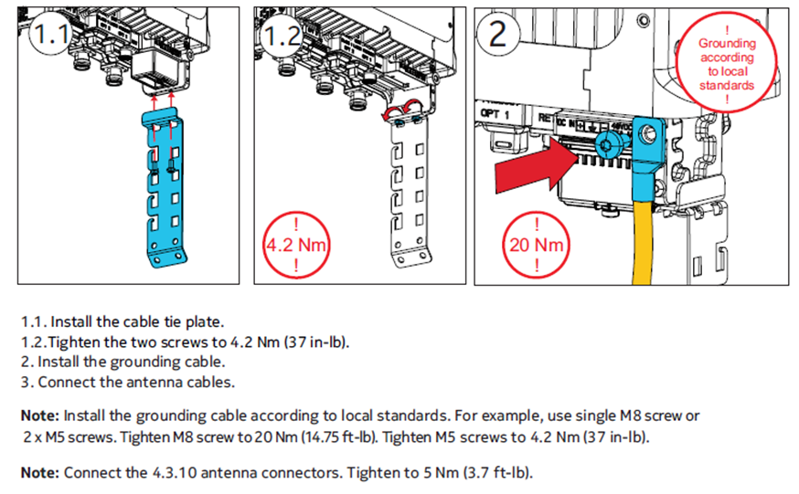
3. Cabling the Radio Unit on ground:

Slide 18
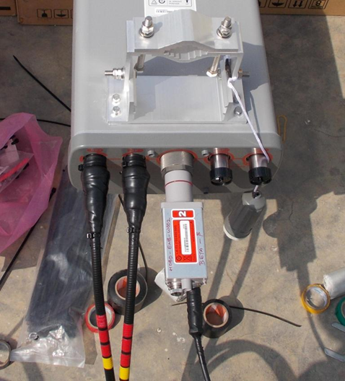
Figure 15 Labeling of RF Jumpers

Slide 19
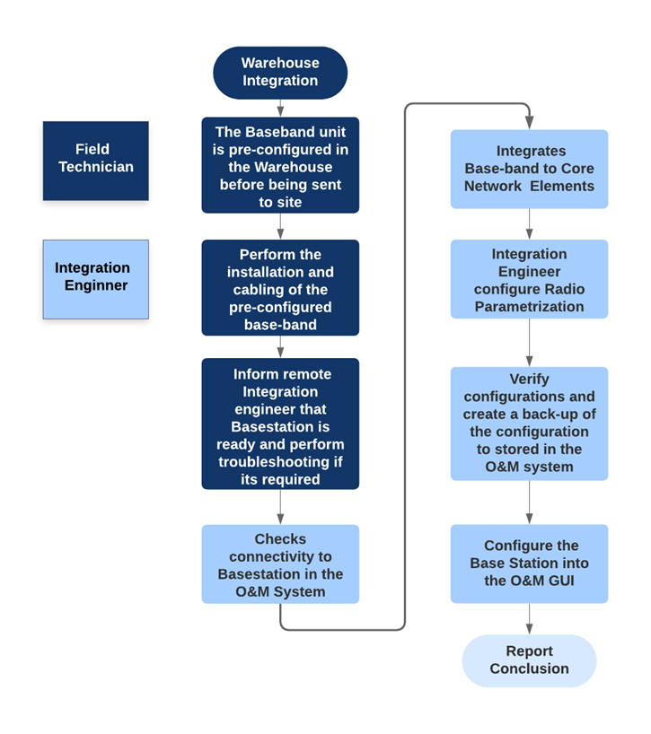
Figure 16 Warehouse commissioning and integration

Slide 20
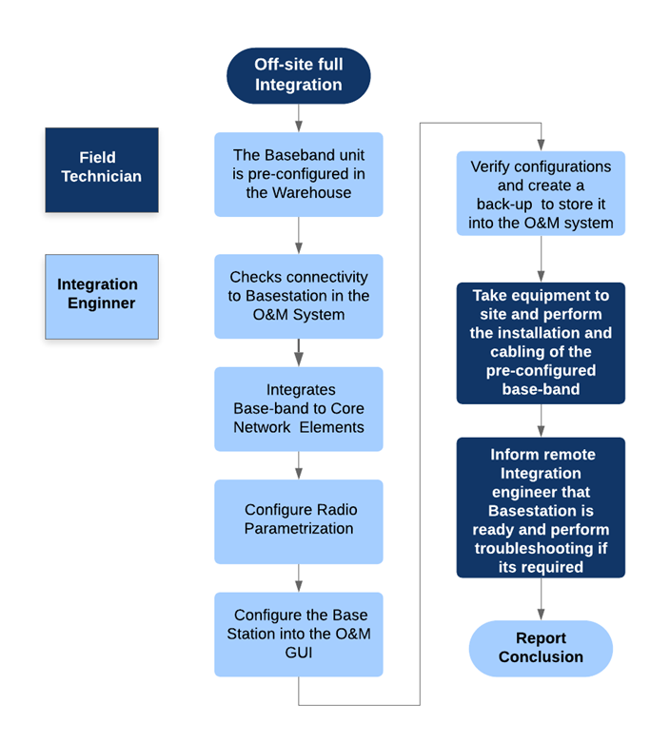
Figure 17 Off-site full Integration Process

Slide 21
2. Connect LAN cable (RJ45) to Base Station port LMT and Laptop in LAN
Port:

Slide 22
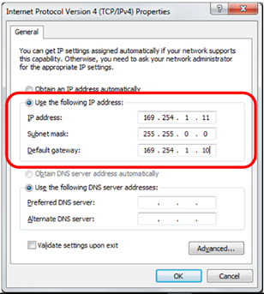
Set IP client as follows (Use the real IP of the Base Station):

Slide 23
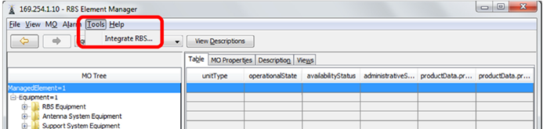
Click Tools _ Integrate Base Station (Best Practice: Use Actual Image of the Tasks):

Slide 24
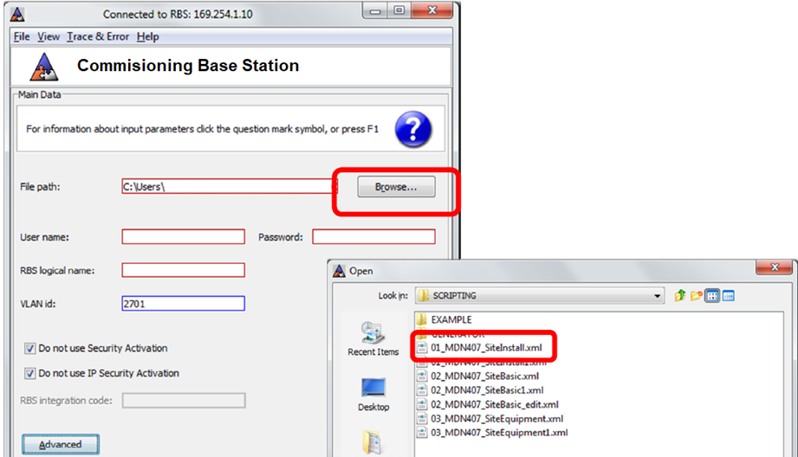
2. Click Browse _ Select Site Install script (Best Practice: Use Actual Image of the Tasks):

Slide 25
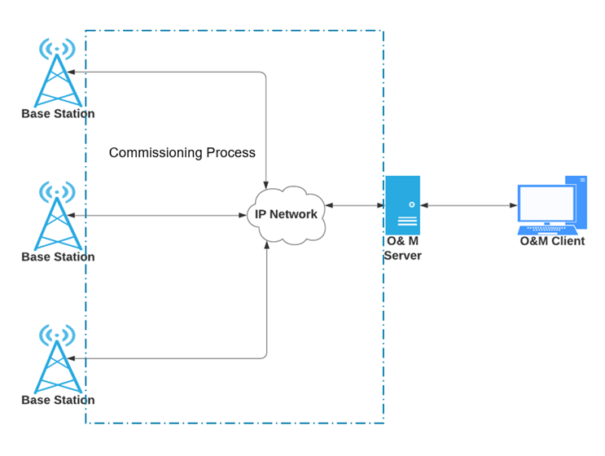
Figure 16 O&M Architecture and interactions between Commissioning and Integration Procedures

Slide 26
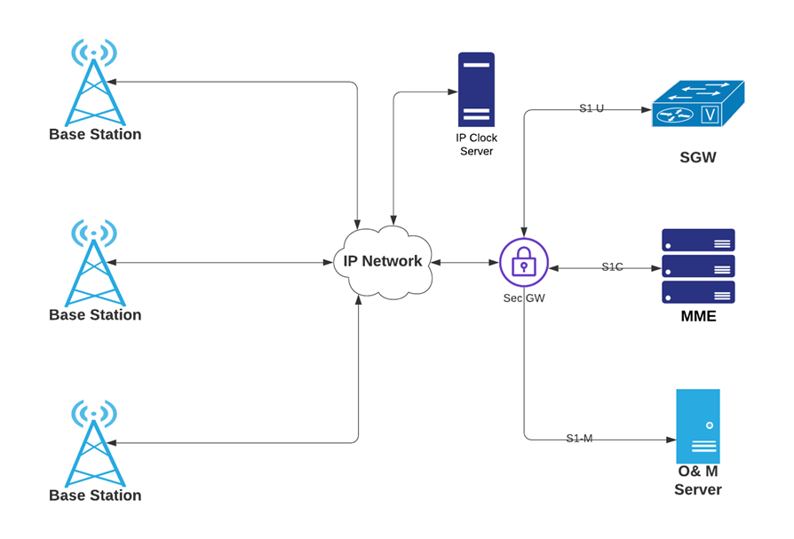
Figure 17 IP Configuration of the RAN Network Elements

Slide 27
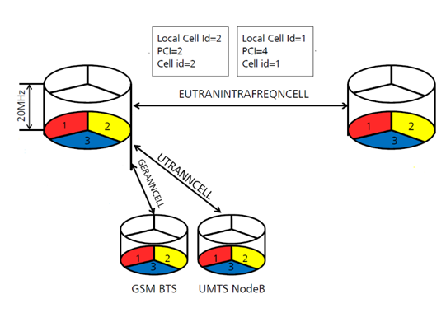
Figure 18 Enabled Functionalities during RF Parametrization

